Slide 1

HungerMate
Haricharan Mukthineni
Gabriel Braun
Christopher Mendoza

Slide 2

Introduction
For this project, we have been tasked with creating a command line application that allows users to place a food order from a restaurant. This application will allow users to filter their selections based on the culture of the food such as Chinese, Mexican, Indian, etc. Customers will then be allowed to customize their food, choose a delivery method, and finalize their order with their payment information. The orders received will be stored in a MySQL database. This project proposal outlines the design and development of a user interface that makes use of database integration and agile approaches to give users a customized and dynamic experience.

Slide 3

Statement of problem
Today about 60% of consumers in the U.S order delivery or takeout once a week. Digital Ordering has grown over 300% faster since 2014. A lack of an online ordering service leads to a restaurant losing on potential sales because the customer might decide to go somewhere else if they don’t have the convenience of ordering online. We will be implementing an application that addresses food customers' needs of having access to online ordering.

Slide 4

Intent of study
The intent of this study is to create a food ordering application which gives hungry customers the convenience of ordering food online. The proposed system aims to streamline the food ordering process, improve customer satisfaction, and enhance operational efficiency for participating restaurants.

Slide 5

Research Questions
Does this app provide ease of use?
What features or services do customers value most in an online food ordering platform?
How do existing platforms differentiate themselves, and what opportunities exist for innovation?

Slide 6
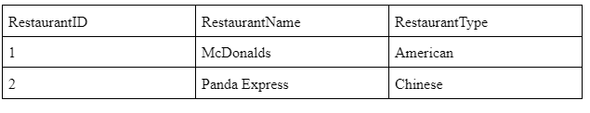
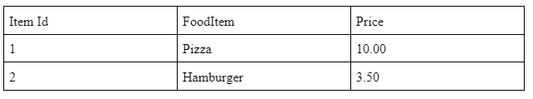
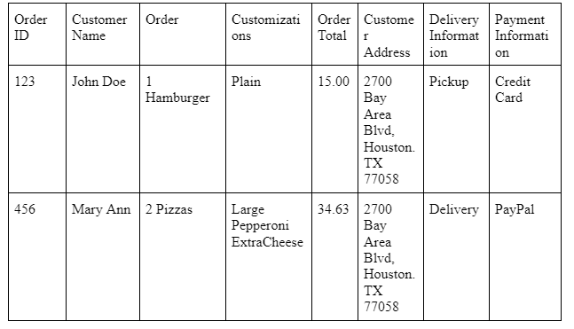
SamPle Data

Slide 7

Methodology
SCRUM Process
APPLICATION: C++ Application
IDE: Visual Studio
DATABASE: CSV File
TECHNIQUES: Component Based Development

Slide 8

Timeline
MILESTONE | Start Date | End Date
Project Proposal | 03/30/2024 | 04/04/2024
User Stories | 04/05/2024 | 04/07/2024
Feature 1 | 04/08/2024 | 04/14/2024
Feature 2 | 04/15/2024 | 04/22/2024
Final Delivery | 04/28/2024 | 05/05/2024

